Slide 1
Image Optimization

Slide 2
What is Image Optimization?
image optimization is the act of decreasing file size without losing quality. You can optimize your images in the creation phase (by using the right “Export” options in Photoshop) or directly on your website (by using lazy load to display media on your site). The goal is to reduce the amount of data a user has to download, so they can get the content they’re looking for faster without sacrificing quality.

Slide 3
Why Optimize Images for the Web?
By taking advantage of image optimization best practices, you’ll keep your file size small and your load time fast, creating a better experience for your site visitors.
Images take up disk space on the server powering your site. Most hosting providers enforce a bandwidth limit per plan, meaning you don’t have unlimited resources—and your images will quickly take up that space.
While it’s not the end of the world if you exceed that limit, you may get charged an overage fee, or worse, have your website shut down.

Slide 4
How to Optimize Images for the Web
Follow these steps to optimize your images for better site performance:
Benchmark your current site speed.
Know how to choose the best image file type.
Resize your images before exporting.
Compress images to reduce file size.
Automate image optimization with a WordPress plugin.
Use the “blur up” technique to load a Lower Quality Image first.
Use lazy loading.

Slide 5
Benchmark Your Current Site Speed
Before you do all this work to optimize your images, start by running a speed test on your site! By the end, you’ll be able to see the impact you’ve made. Some popular speed testing tools are:
Google PageSpeed Insights
Pingdom Tools
GTMetrix
WebPageTest
These browser-based tools all work pretty similar to each other: Open the link, then enter your URL for a quick report about your site’s speed and performance.

Slide 6
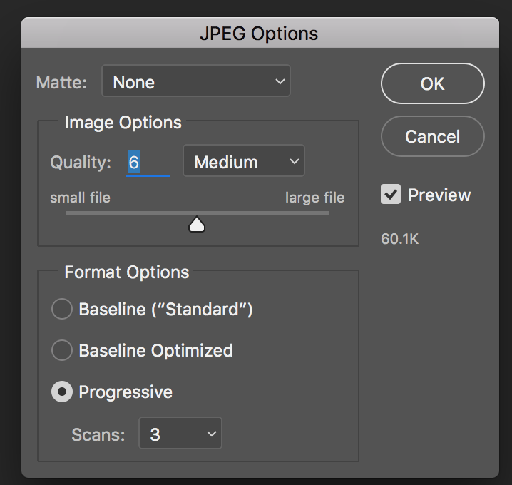
Know How to Choose the Best Image File Type
The most common file types for use on the web are JPEGs, PNGs, and GIFs. they all have their own pros, cons, and best practices when being placed on your website.
JPEGs
JPEG images work best for showing off complex color photographs on your site, as they allow for a higher-quality image with a smaller file size. This file type will probably work for the majority of images you want to use on your site, with one major exception: images with a transparent background.
When using a JPEG image for your website, consider exporting it as “Progressive.” This allows the browser to instantly load a simple version of the image before fully loading the full resolution onto the site.
If you’re working in Photoshop, you’ll find this setting when you export as “Save for Web.”
File > Save As, select JPG from the Format drop-down menu, tick Progressive in the subsequent dialogue box.

Slide 7
PNGs
If you don’t have a ton of color in your image (like flat illustrations or icons), or want it to have a transparent background, it is recommended exporting as a PNG. Make sure you have the right image dimensions, and look for the option to save as PNG-24 (or 8, if there’s no quality loss).
GIFs
The third most common image format for the web are GIFs. They only support 256 colors, so you’ll have to be selective with this file type!
To optimize GIFs for your website, think critically about how long they last, if they need to loop, and how many you really need on a given page or site.

Slide 8
Resize Your Images Before You Upload
One of the easiest ways to optimize images for the web is to resize them before you upload them to your site. Especially if you’re working with raw images from a DSLR camera, the dimensions are often much larger than you actually need.
By cropping or resizing your images before uploading, you’ll decrease the file size, which will help your site load just a little bit faster and save your disk space for even more images.

Slide 9
Compress Images to Reduce File Size
Once you have your final image, saved in the right format and cropped to an appropriate size, there’s one more step you can take to optimize it before uploading to your site: compressing it.
This process will help you make the file size smaller without losing noticeable image quality.
TinyPNG: A free browser-based tool for compressing PNG and JPEG images.
ImageOptim: A free open-source app for compressing images.
JPEGmini: A photo recompressing app for Mac and Windows.
RIOT: A free Windows app for optimizing images.
Image Optimizer: A free Add-on for Local.

Slide 10
Use the “Blur Up” Technique to Load a Lower Quality Image First
Even after all the previous optimization steps, there are cases where you still might be working with large file sizes or lots of images on a page, slowing down your site speed. In those cases, sometimes it’s helpful to not only optimize images, but to optimize the load experience so site visitors think your media files are loading faster than they really are.
One way to do this is to load a Lower Quality Image (LQI) first. By loading a smaller version of the image before loading the full size, it gives the user something to look at while they wait for all the details. This gives the perception of a faster load time even if, technically, everything is loading at the same rate.

Slide 11
Lazy Load Your Site Images
Similar to the “blur up” technique, there’s one more trick that will help you give the appearance of faster loading images: Lazy loading.
When someone lands on your site, they start at the top of the page. It’s probably going to take them a moment to scroll the entire page, especially if they’re engaged. Instead of trying to load all the images at once, lazy loading acts under the assumption that users care most about the content they can see. So, the images within their browser view fully load first, while the other images load a placeholder first, until the user scrolls to that section of the page.

Slide 12
Lazy Loading is a set of techniques in web and application development that defers the loading of resources on a page to a later point in time—when those resources are actually needed instead of loading them up front. These techniques help in improving performance, better utilization of the device’s resources and reducing associated costs.
<img src="URL" loading="eager|lazy">
Value | Description
eager | Default. Loads an image immediately
lazy | Defer loading of images until some conditions are met

Slide 13
CSS image-rendering Property
Basically, rendering images is just the device transforming the data it collects into an image
the different algorithms that can be used for image scaling:
.image { height: 100px; width: 100px; image-rendering: auto; } .crisp-edges { image-rendering: -webkit-optimize-contrast; image-rendering: crisp-edges; } .pixelated { image-rendering: pixelated; } .smooth { image-rendering: smooth; } .high-quality { image-rendering: high-quality; }

Slide 14
<body>
<h1>The image-rendering Property</h1>
<p>image-rendering: auto;</p>
<img class="image" src="smiley.gif" alt="Smiley" width="32" height="32">
<p>image-rendering: crisp-edges;</p>
<img class="image crisp-edges" src="smiley.gif" alt="Smiley" width="32" height="32">
<p>image-rendering: pixelated;</p>
<img class="image pixelated" src="smiley.gif" alt="Smiley" width="32" height="32">
<p>image-rendering: smooth;</p>
<img class="image smooth" src="smiley.gif" alt="Smiley" width="32" height="32">
<p>image-rendering: high-quality;</p>
<img class="image high-quality" src="smiley.gif" alt="Smiley" width="32" height="32">
<p>Original image: <img src="smiley.gif" alt="Smiley" width="32" height="32"></p>
</body>
<style>
.image {
height: 100px;
width: 100px;
image-rendering: auto;
}
.crisp-edges {
image-rendering: -webkit-optimize-contrast; /* Chrome, Edge, Opera, and Safari */
image-rendering: crisp-edges;
}
.pixelated {
image-rendering: pixelated;
}
.smooth {
image-rendering: smooth;
}
.high-quality {
image-rendering: high-quality;
}
</style>

Slide 15
@keyframes Rule
The @keyframes rule specifies the animation code.
The animation is created by gradually changing from one set of CSS styles to another.
During the animation, you can change the set of CSS styles many times.
Specify when the style change will happen in percent, or with the keywords "from" and "to", which is the same as 0% and 100%. 0% is the beginning of the animation, 100% is when the animation is complete.

Slide 16
Make an element move gradually 200px down:
<!DOCTYPE html>
<html>
<head>
<style>
div {
width: 100px;
height: 100px;
background: red;
position: relative;
animation: mymove 5s infinite;
}
@keyframes mymove {
from {top: 0px;}
to {top: 200px;}
}
</style>
</head>
<body>
<h1>The @keyframes Rule</h1>
<div></div>
</body>
</html>

Slide 17
Many keyframe selectors with many CSS styles:
@keyframes mymove {
0% {top: 0px; left: 0px; background: red;}
25% {top: 0px; left: 100px; background: blue;}
50% {top: 100px; left: 100px; background: yellow;}
75% {top: 100px; left: 0px; background: green;}
100% {top: 0px; left: 0px; background: red;}
}
</style>
</head>
<body>
<h1>The @keyframes Rule</h1>
<div></div>
</body>
</html>
<!DOCTYPE html>
<html>
<head>
<style>
div {
width: 100px;
height: 100px;
background: red;
position: relative;
animation: mymove 5s infinite;
}

Slide 18
Change many CSS styles in one animation:
<!DOCTYPE html>
<html>
<head>
<style>
div {
width: 100px;
height: 100px;
background: red;
position: relative;
animation: mymove 5s infinite;
}
@keyframes mymove {
0% {top: 0px; background: red; width: 100px;}
100% {top: 200px; background: yellow; width: 300px;}
}
</style>
</head>
<body>
<h1>The @keyframes Rule</h1>
<div></div>
</body>
</html>

Slide 19
Responsive images
Text on the web automatically wraps at the edge of the screen so that it doesn't overflow. It's different with images. Images have an intrinsic size. If an image is wider than the screen, the image will overflow, causing a horizontal scrollbar to appear.

Slide 20
In your stylesheet, you can declare that images should never be rendered at a size wider than their containing element using max-inline-size.
img { max-inline-size: 100%; block-size: auto; }
You can apply the same rule to other kinds of embedded content too, like videos and iframes.
img, video, iframe { max-inline-size: 100%; block-size: auto; }

Slide 21
If the width property is set to a percentage and the height property is set to "auto", the image will be responsive and scale up and down:
img { width: 100%; height: auto; }
If the max-width property is set to 100%, the image will scale down if it has to, but never scale up to be larger than its original size:
img { max-width: 100%; height: auto; }

Slide 22
If the background-size property is set to "contain", the background image will scale, and try to fit the content area. However, the image will keep its aspect ratio (the proportional relationship between the image's width and height):
div { width: 100%; height: 400px; background-image: url('img_flowers.jpg'); background-repeat: no-repeat; background-size: contain; border: 1px solid red; }

Slide 23
If the background-size property is set to "100% 100%", the background image will stretch to cover the entire content area:
div { width: 100%; height: 400px; background-image: url('img_flowers.jpg'); background-size: 100% 100%; border: 1px solid red; }

Slide 24
If the background-size property is set to "cover", the background image will scale to cover the entire content area. Notice that the "cover" value keeps the aspect ratio, and some part of the background image may be clipped:
div { width: 100%; height: 400px; background-image: url('img_flowers.jpg'); background-size: cover; border: 1px solid red; }

Slide 25
A large image can be perfect on a big computer screen, but useless on a small device. Why load a large image when you have to scale it down anyway? To reduce the load, or for any other reasons, you can use media queries to display different images on different devices.
/* For width smaller than 400px: */ body { background-image: url('img_smallflower.jpg'); } /* For width 400px and larger: */ @media only screen and (min-width: 400px) { body { background-image: url('img_flowers.jpg'); } }

Slide 26
You can use the media query min-device-width, instead of min-width, which checks the device width, instead of the browser width. Then the image will not change when you resize the browser window:
/* For devices smaller than 400px: */ body { background-image: url('img_smallflower.jpg'); } /* For devices 400px and larger: */ @media only screen and (min-device-width: 400px) { body { background-image: url('img_flowers.jpg'); } }

Slide 27
The most common use of the <picture> element will be for images used in responsive designs. Instead of having one image that is scaled up or down based on the viewport width, multiple images can be designed to more nicely fill the browser viewport.
The <picture> element works similar to the <video> and <audio> elements. You set up different sources, and the first source that fits the preferences is the one being used:
<picture> <source srcset="img_smallflower.jpg" media="(max-width: 400px)"> <source srcset="img_flowers.jpg"> <img src="img_flowers.jpg" alt="Flowers"> </picture>

Slide 28
Five different way for responsive images
Using max-width:
img {
max-width: 100%;
height: auto;
}
Using percentage-based width:
img {
width: 100%;
height: auto;
}

Slide 29
Using viewport units:
img {
width: 100vw;
height: auto;
}
viewport width
Using media queries:
img {
width: 100%;
height: auto;
}
@media (max-width: 768px) {
img {
width: 50%;
}
}

Slide 30
Using flexbox:
.container {
display: flex;
justify-content: center;
}
img {
max-width: 100%;
height: auto;
}

